Slide 2
Mental Health Section G

Slide 3
Objectives
Understanding Mental health Section G
Clinical examples for better understanding
Knowledge Check
Exercises

Slide 4
Mental Health Section G
Mental Health contains specific values in the third and fourth characters to describe mental health procedures. The remaining characters function as placeholders only.
Third character describes the mental health procedure root type.
Fourth character further specifies the procedure type as needed.
Second, fifth, sixth, and seventh characters do not convey specific information about the procedure. The value Z functions as a placeholder in these characters.

Slide 5
Mental Health Section G
Root Type:
The third character describes the mental health root type. There are 11 root type values in this section, as listed below-
1: Psychological Tests- is a series of tests conducted by a psychologist, to gather information about how people think, feel, behave and react. The findings are used to develop a report of the person’s abilities and behavior—known as a psychological report—which is then used as a basis to make recommendations for the individual’s treatment.
2: Crisis Intervention- Treatment of a traumatized, acutely disturbed or distressed individual for the purpose of short-term stabilization.
5: Individual Psychotherapy- Treatment of an individual with a mental health disorder by behavioral, cognitive, psychoanalytic, psychodynamic or psychophysiological means to improve functioning or well-being.
6: Counselling –The application of psychological methods to treat an individual with normal developmental issues and psychological problems in order to increase function, improve well-being, alleviate distress, maladjustment or resolve crises.

Slide 6
Mental Health Section G
7: Family Psychotherapy- Treatment that includes one or more family members of an individual with a mental health disorder by behavioral, cognitive, psychoanalytic, psychodynamic or psychophysiological means to improve functioning or well-being
B: Electroconvulsive Therapy-Electroconvulsive therapy is the application of controlled electrical voltages to treat a mental health disorder.
C: Biofeedback - Provision of information from the monitoring and regulating of physiological processes in conjunction with cognitive-behavioral techniques to improve patient functioning or well-being.
F: Hypnosis Therapy- technique that utilizes hypnosis to aid in the treatment of specific symptoms or health conditions. Hypnotherapy works by inducing a hypnotic state marked by waking awareness that allows people to experience detached external attention and to focus on inner experiences.

Slide 7
Mental Health Section G
G: Narcosynthesis- Administration of intravenous barbiturates in order to release suppressed or repressed thoughts
H: Group Therapy- group therapy is a form of psychotherapy in which one or more therapists treat a small group of clients together as a group
J: Light Therapy- Application of specialized light treatments to improve functioning or well-being.

Slide 8
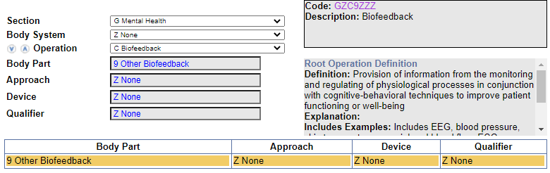
Clinical Example 1
Galvanic skin response (GSR) biofeedback
Code: GZC9ZZZ (Biofeedback)
Coding Navigation:

Slide 9
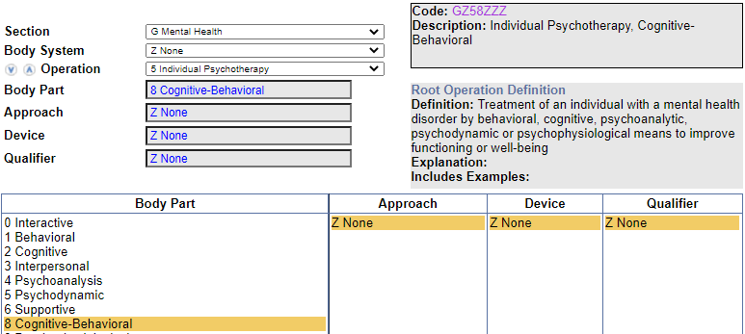
Clinical Example 2
Cognitive-behavioral psychotherapy, individual
Code: GZ58ZZZ (Individual Psychotherapy, Cognitive-Behavioral)
Coding Navigation:

Slide 10
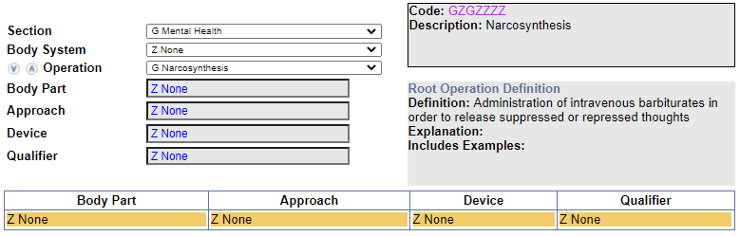
Knowledge Check 1
What is the code assignment for Narcosynthesis?
Codes: GZGZZZZ (Narcosynthesis)
Code Navigation:

Slide 11
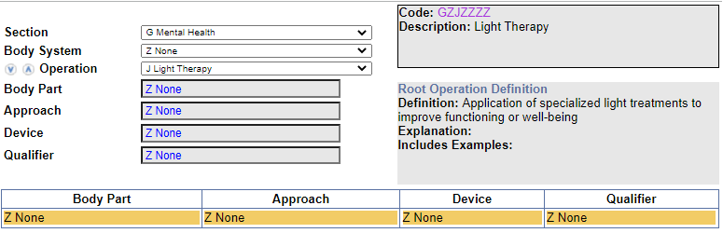
Knowledge Check 2
What is the code assignment for Light therapy?
Code: GZJZZZZ (Light Therapy)
Code Navigation:

Slide 12
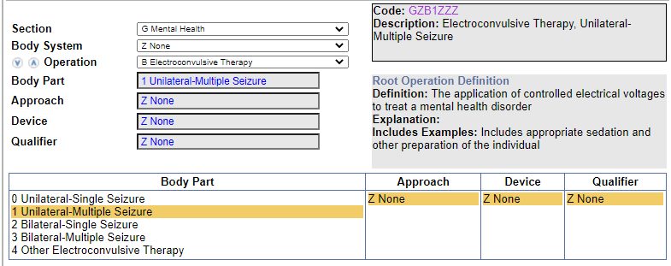
Exercise 1
What is the code assignment for ECT (Electroconvulsive therapy), unilateral, multiple seizure?
Code: GZB1ZZZ (Electroconvulsive Therapy, Unilateral-Multiple Seizure)
Code Navigation:

Slide 13
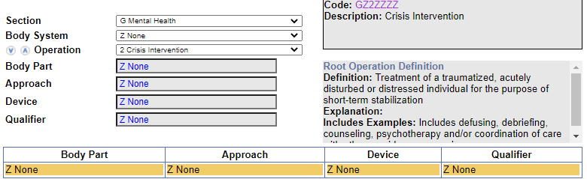
Exercise 2
What is the code assignment for Crisis intervention?
Code: GZ2ZZZZ (Crisis Intervention)
Code Navigation:

Slide 14
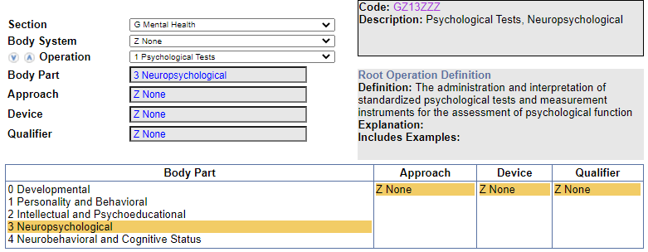
Exercise 3
What is the code assignment for Neuropsychological testing?
Code: GZ13ZZZ (Psychological Tests, Neuropsychological)
Code Navigation:

Slide 15
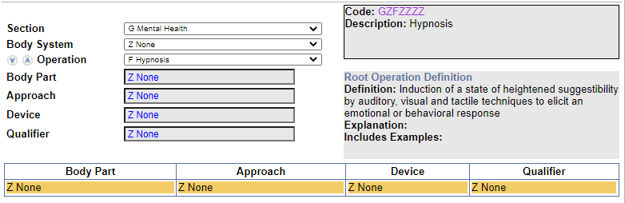
Exercise 4
What is the code assignment for Hypnosis?
Code: GZFZZZZ (Hypnosis)
Code Navigation:

Slide 16
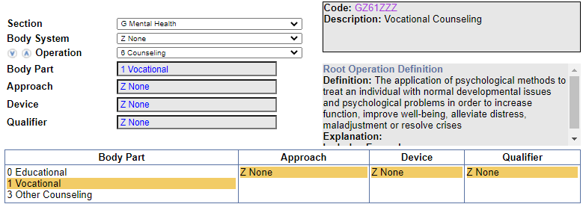
Exercise 5
What is the code assignment for Vocational counselling?
Code:GZ61ZZZ (Vocational Counseling)
Code Navigation:

Slide 17
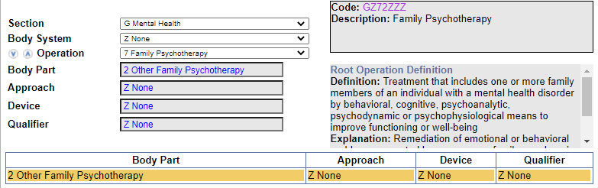
Exercise 6
What is the code assignment for Family psychotherapy ?
Code: GZ72ZZZ (Family Psychotherapy)
Code Navigation:

Slide 18
Thank You

